Slide 1
Project 1：Image Filtering and Hybrid Images
时间：2023/ 03 / 24
主讲人：林楷浩

Slide 2
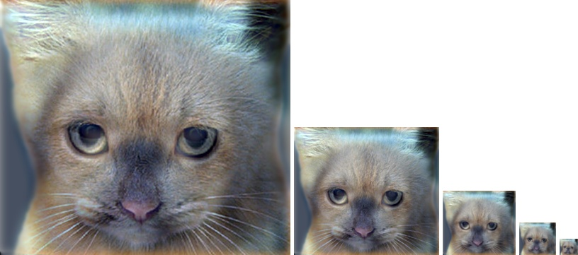
Project 1：Hybrid image
Cat？
Dog？

Slide 3
Project 1：Hybrid image
Cat？
Dog？

Slide 4
Project 1：Hybrid image
The basic idea is that high frequency tends to dominate perception when it is available but, at a distance, only the low frequency (smooth) part of the signal can be seen.
Cat？
Dog？
high frequency
low frequency

Slide 5
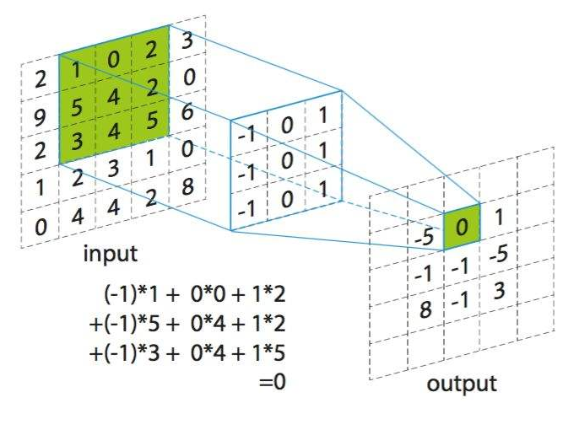
Process image

Slide 6
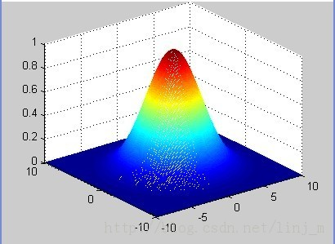
Gaussian kernels
高斯滤波的具体操作是：用一个模板（或称卷积、掩模）扫描图像中的每一个像素，用模板确定的邻域内像素的加权平均灰度值去替代模板中心像素点的值用。
高斯模糊：我们常说的高斯模糊就是使用高斯滤波器完成的，高斯模糊是低通滤波的一种，也就是滤波函数是低通高斯函数，但是高斯滤波是指用高斯函数作为滤波函数，至于是不是模糊，要看是高斯低通还是高斯高通，低通就是模糊，高通就是锐化。

Slide 7
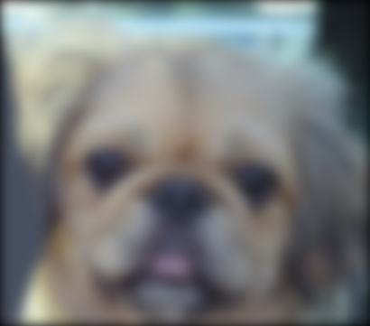
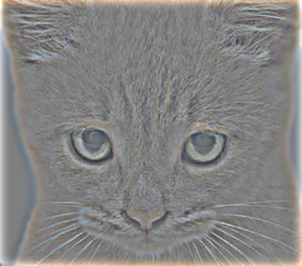
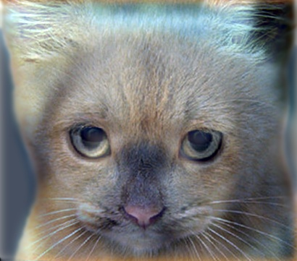
Part 1： Image Filtering/Convolution
low_frequencies
high_frequencies
Hybrid image
Low_frequencies：Use Gaussian kernel for blurring images
High_frequencies：Use Gaussian kernel for blurring images，original image – low_frequencies
Hybrid image：A hybrid image is the sum of a low-pass filtered version of one image and a high-pass filtered version of another image

Slide 8
Part 1：Numpy
How to do？
In part1.py，Implement the following functions：
def create_Gaussian_kernel(cutoff_frequency)
def my_imfilter(image, filter)
def create_hybrid_image(image1, image2, filter)
Test in proj1.ipynb
Go to the Code and notebook

Slide 9
Part 2：Pytorch
Standard Dataset：
In torchvision.datasets，Standard datasets：MNIST、COCO、CIFAR
Custom Dataset：
def __len__(self) -> int
def __getitem__(self, idx: int) -> Tuple[torch.Tensor, torch.Tensor, int]
Model:
def forward(self, image1, image2, cutoff_frequency)
Go to the code and notebook

Slide 10
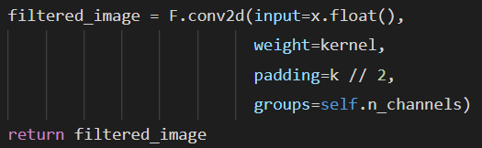
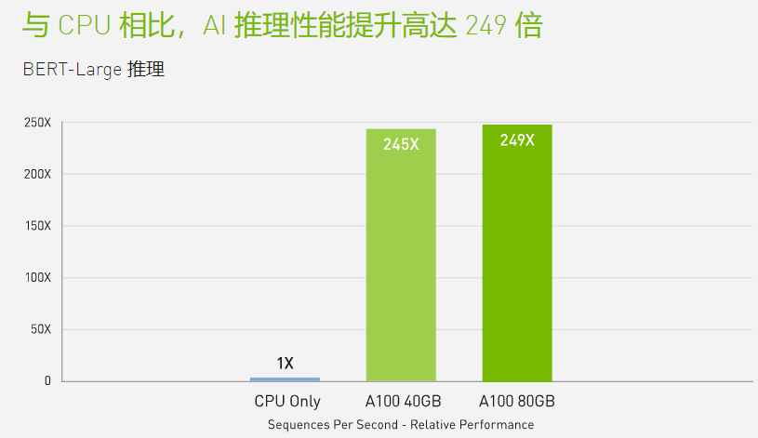
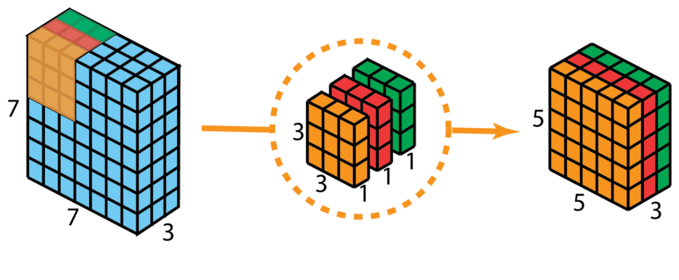
Part 2：Pytorch
Why Pytorch？
CPU：AMD Ryzen Threadripper 3990X 64 core
GPU：NVIDIA RTX2080Ti (4352 core)

Slide 11
Work
implement the following functions in part1.py
def my_imfilter(image, filter):
{
}
Potentially useful NumPy (Python library) functions:
import numpy as np
np.pad(), which does many kinds of image padding for you；
np.clip(), which “clips” out any values in an array outside of a specified range；
np.sum() and np.multiply() , which makes it efficient to do the convolution (dot product) between the filter and windows of the image.
ndarray.shape, return the dimension; ndarray[10:20, 10:20, 1], array slice
Test in proj1_test_filtering.ipynb

Slide 12
谢谢大家观看！！ Thanks！

